Slide 1
Bias-Correcting NA-CORDEX: A Case Study in Parallelizing Data Analysis
Seth McGinnis
2017-06-29

Slide 2
Acknowledgements
This work supported in part by:
DoD ESTCP grant 201666
DoD SERDP grant #2526
NSF award CMMI 1635638/1635686
DoE award DESC0016438

Slide 3
Overview
About Me
About the Data: NA-CORDEX
About the Task: Bias Correction
The Challenge!
Approaches to Parallelization
(Re-) Organizing the Problem
What I Ended Up Doing
How Long It Took
What Went Wrong
The End Result
What Comes Next

Slide 4

Who I Am and What I Do
Associate Scientist IV
CISL / IMAGe / RISC (Regional Integrated Sciences Collective)
Our group connects regional climate modeling to impacts
Data manager
NARCCAP
NA-CORDEX
Archive, publish data
Derived data products
Bias correction
No previous experience with parallel computing

Slide 5
About the Data: NA-CORDEX

Slide 6
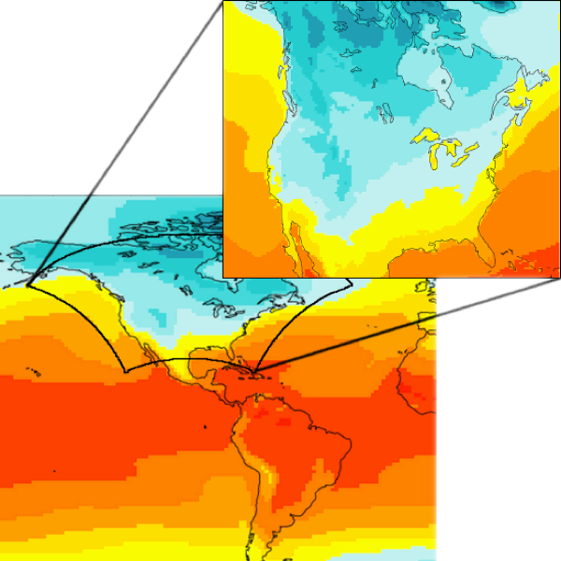
Regional Climate Modeling in NARCCAP & NA-CORDEX
Nest high-resolution regional models (RCMs) inside coarser global models (GCMs) over North America
Better mountains & coasts
Better land surface detail
Better convective processes
Closer to impacts scale

Slide 7
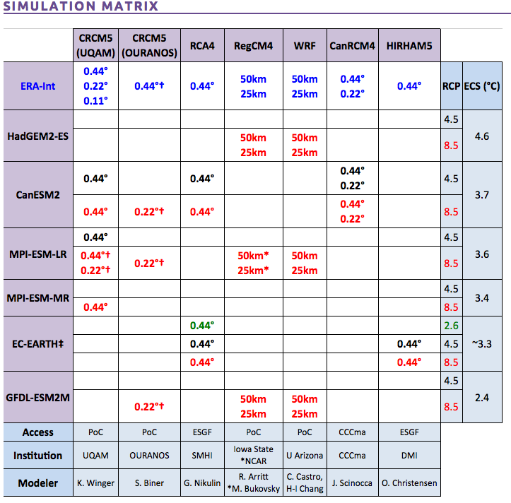
NA-CORDEX
North American branch of CORDEX program
Archive for impacts users:
http://na-cordex.org
7 RCMs, 7 GCMs, 2 RCPs
50-km, 25-km resolution
Daily data running 1950-2100
Big 7 impacts variables
Many derived data products, including bias-corrected data

Slide 8
About the Task: Bias Correction

Slide 9
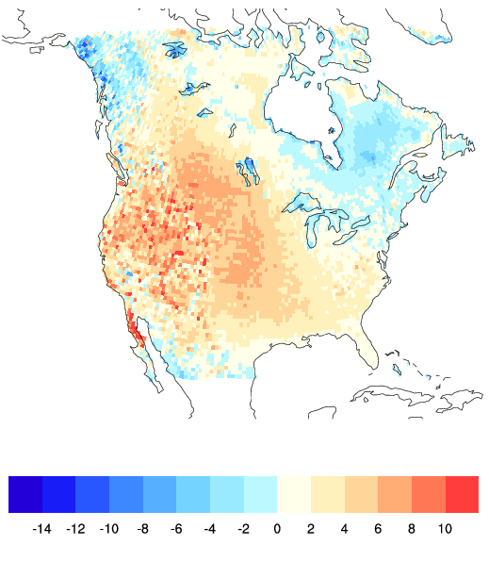
Bias Correction
Summer RCM Temperature Bias (°C)
Impacts research needs high-resolution future climate data
RCMs & GCMs have bias
Correcting bias makes data more useable

Slide 10
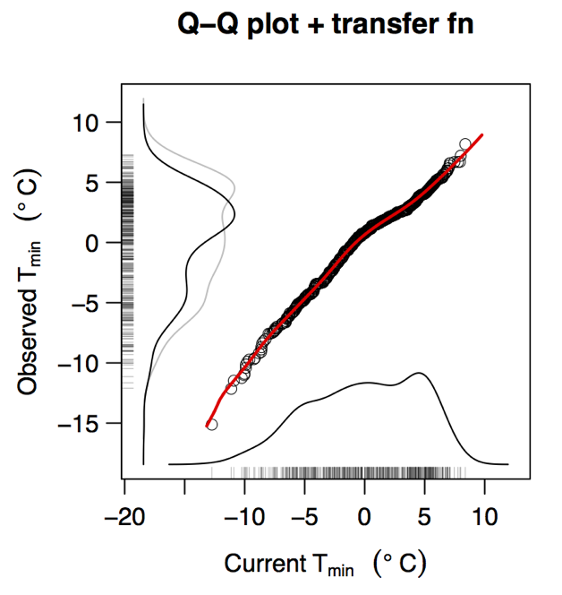
Distribution Mapping
Teutschbein & Seibert (2012) Journal of Hydrology: Best all-around performance among methods tested
Want the PDF of model data to match the PDF of observations.
Construct transfer function that maps values from one dataset onto the other by equating CDFs

Slide 11
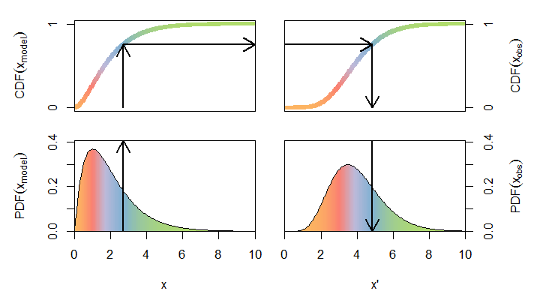
Mapping: value➟ probability ➟ value

Slide 12
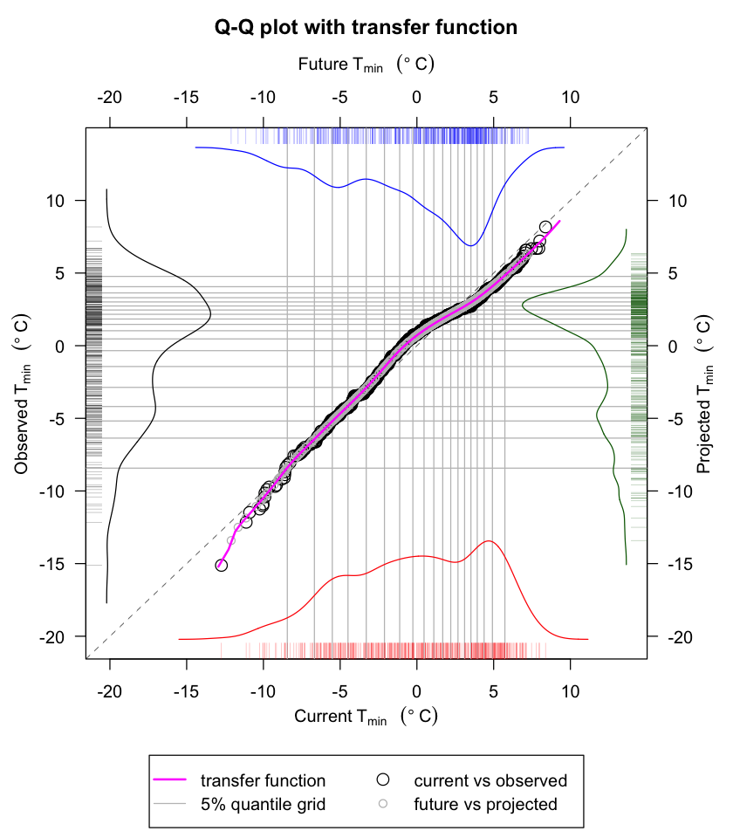
Kernel Density Distribution Mapping
Oracle analysis shows this is best implementation of distribution mapping [McGinnis, et al. (2015)]
Naturally accommodates different size datasets
GCM calendars vs. obs
Leap years
Wet/dry days
Missing data
Uses non-parametric PDFs

Slide 13
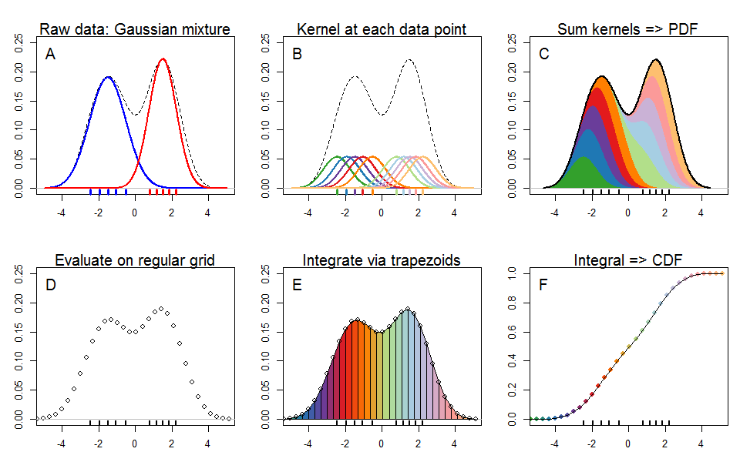
Use Kernel Density Estimation (KDE) to find CDF for unknown distributions

Slide 14
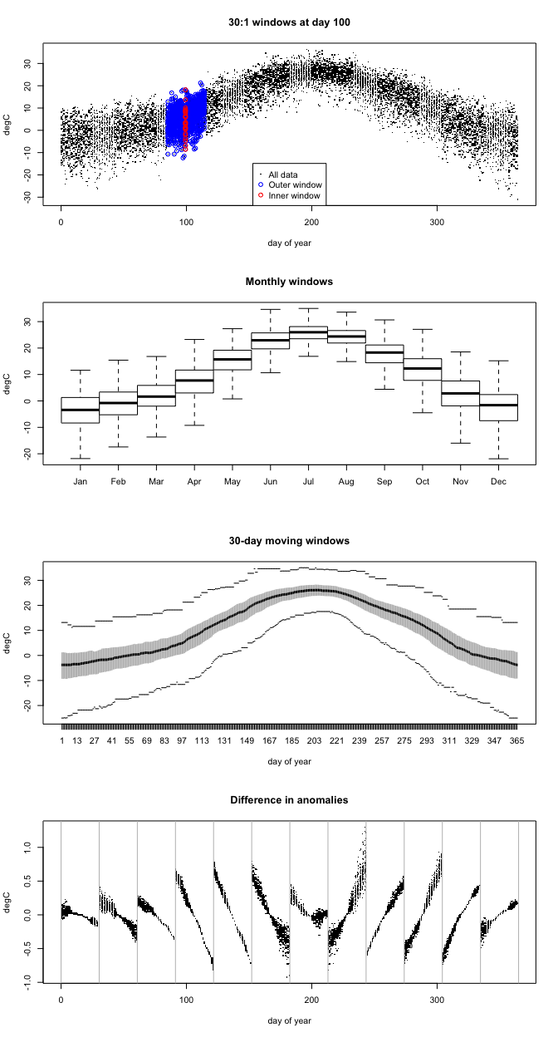
Application of KDDM
Use moving windows to handle seasonality
Nest windows to get enough data for good estimate of PDF
Normalize to stabilize variance and remove non-stationarity
Procedure:
Window
Normalize
KDDM
Denormalize
Recombine

Slide 15
The Challenge
Bias correction script works
~22 seconds to correct one timeseries
End of January: “Can you bias-correct the 3x2 NA-CORDEX runs by mid-March?”

Slide 16

The Math
3 variables* 3 GCMs
2 RCMs
600 x 258 gridcells
232 x 154 (CONUS only)
x________________
643,104 timeseries
*prec, tmin, tmax
643k x 22 seconds
= 14 million CPU-sec
= 3,930 CPU-hours
= 164 days
= 23+ weeks
23 weeks >> 6 weeks
(Feb 1 to March 15)

Slide 17
The Decision
This is an embarrassingly parallel problem
We have lots of allocation available
Recent technote on Rmpi on yellowstone
Stretch goals look good on annual review
Challenge Accepted!

Slide 18
Approaches to Parallelization

Slide 19
Rmpi
Promise
Package for R
My bias-correction code is also written in R
Good for independent parallelism
Simple Supervisor / Worker paradigm
Auto load balancing
Problems
Version mismatches (R, MPI, R pkgs)
Supervisor memory footprint (44 GB input)
How much to send to each worker?
Trouble capturing output (and finding it)

Slide 20
“Try the command file approach”
Call mpirun.lsf from LSF batch file: mpirun.lsf -cmdfile tasks.cmd
Command file: one task per line one task per core
Wrap commands in one-line shell call to capture output: tcsh –c “Rscript --vanilla bc.R file1 file2 file3”
Perfect match to existing code

Slide 21
Parallel I/O
File contention
Too many simultaneous readers saturates bandwidth to parallel file system nodes
No time to check!
Regardless, no good tools for parallel netcdf write in R
: (

Slide 22
(Re-) Organizing the Problem

Slide 23
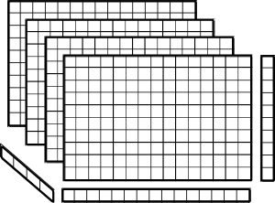
Disassemble NetCDF file
Components:
Global attributes
Ancillary (lat, lon, etc.)
Time coordinate
Main data variable
Slice data by lon
Slice each slice into rods (timeseries) by lat
257 x lat
time
600 x lon

Slide 24
Job Scheduling Advice
h/t: Rory Kelly
Yellowstone: ~75k cores
Typically free: 5-7% = 4-5k
Wallclock < 15 min = short (easy to schedule, can be used to backfill)
Aim for 10 minutes max
64 nodes = 1024 cores is typical job size
~500 core jobs should easily fit into backfill holes, and sometimes you can fit 2 into a hole
NB: for small jobs, premium queue is better than small queue
Queue | Wall clock | Max Nodes | Priority | Cost
premium | 12 hr | 1024 | 2 | x 1.5
small | 2 hr | 256 | 2.5 | x 1.5

Slide 25
What I Ended Up Doing

Slide 26
Disassembly (Stage 1 & 2)
Stage 1: component separation
various NCO commands, run on geyser
takes a few minutes
Stage 2: slicing data
Generating 1 slice takes ~22 seconds x 600 = 3 hrs 40 minuts => parallelize on yellowstone
600 tasks = good job size, so one task per slice
22 sec => 2 min est. wallclock, 10 min max
Actual: 3-4 minutes turnaround time

Slide 27
Disassembly (Stage 3)
Stage 3: slice 600 slices into rods (timeseries)
Looping over lat takes ~11 sec per slice
Can’t do loops in tcsh 1-liners; wrap in bash
Actual turnaround: 2-3 minutes
Use templates + generator scripts to create command file + LSF batch file for each rcm/gcm/variable combination
tcsh (generator) -> bash (wrapper)
quoted + substituted + special strings = madness
Solution: put quoted special strings into variables

Slide 28
Bias Correction
Simple modification of original R script to take command-line args, use disassembled data
Stick with 600 cores, each loops over rods in a single data slice
Unexpected: creating an empty output tree matching the input (with 600 slice subdirs) takes a non-trivial amount of time

Slide 29
Reassembly
Stage 1: merge rods back into slices
Takes ~5 seconds for filesystem to write a slice; 5 sec x 257 = most of an hour, so parallelize
Stage 2: rebuild data block from slices and rebuild NetCDF from components
Can’t be done in parallel; run on geyser

Slide 30
How Long It Took

Slide 31
Reassembly Details
Reassemble slices into data block: 2 min
Reorder dimensions 11 min
Reorder coordinates to match 1 min
Update metadata 0 min*
*if you do it before adding data to the file
Append data 1 min
Append time coordinate 5 min
Append ancillary data 3 min
Grand Total ~ 22 min

Slide 32
Time Taken for Bias Correction
Prec: 172 CPU-hrs , 36 min wallclock per sim
Temp: 295 CPU-hrs, 86 min wallclock per sim
Tmin & Tmax used complicated normalization of interannual variability; precip did not
Total CPU-hrs: 3826
Orig. estimate: 3930
Max turnaround: 99 min (1.65 hrs)
Speedup: x 2300* *actually run in two batches

Slide 33
What Went Wrong
Many, many things
Some problems don’t show up until you try it on the whole dataset
Time alignment: different units, starting dates
Calendar: 365 windows for 360 day year
Not enough wet days in super-arid regions
Weird all-zero locations in obs data
Big error fix means rerunning EVERYTHING

Slide 34
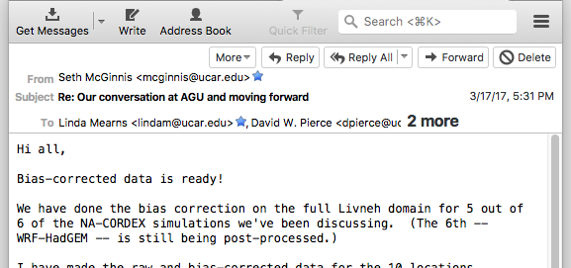
The End Result
Bias corrected: 3 vars x 5 runs x 150 yrs
Total CPU-hours spent: ~ 80,000
Data volume: 570 GB

Slide 35
What Comes Next
R package: climod https://github.com/sethmcg/climod
Further improvements
Better normalization
Seasonal – Trend – Anomaly decomposition
Multivariate bias correction
Solved problem in image processing
The Cloud™

Slide 36
The Cloud – And Questions
This problem is ideal for cloud
Burst demand
Highly parallel
Small task footprint
Cloud vendor briefings
Evaluations
How thin can we spread it out?
Half a million processors for 30 seconds?
Actuall wallclock time
Costs
Ease of use
R packages
Getting data out

Slide 37

Questions?

